Slide 1
DOM IN JAVASCRIPT
Sai Vardhan T

Slide 2
DOM IN JAVASCRIPT
Document Object Model (DOM) is a programming interface for HTML and XML documents.
It represents the page so that programs can change the document's structure, style, and content.
The DOM is an object-oriented representation of a web page, which means that everything on a web page is represented as an object.

Slide 3

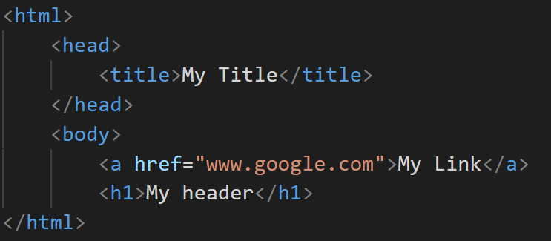
DOM IN JAVASCRIPT

Slide 4
GETTING VALUES FROM HTML TO JS (FORMS)
Document.getelementbyid()
Document.queryselector()
Document.format()
Using this
Using formdata object

Slide 5
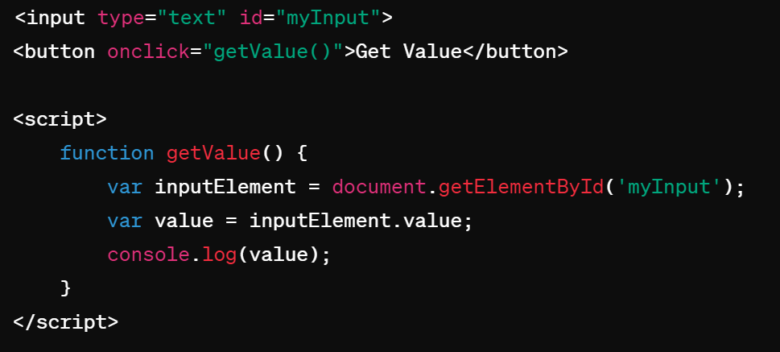
Document.getElementById()
You can retrieve values from form elements by accessing their value property directly or by using the document.getElementById() method to get a reference to the form element.

Slide 6
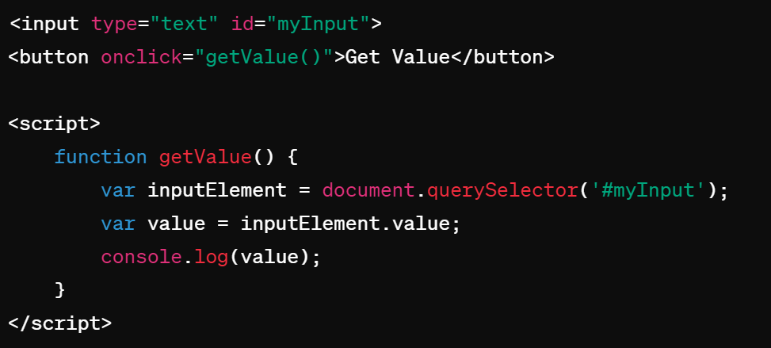
document.querySelector()
Similar to getElementById(), but you can use CSS selectors to retrieve elements.

Slide 7
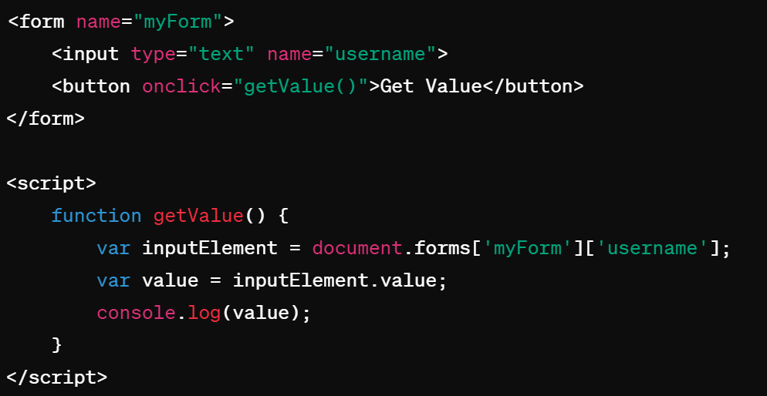
document.forms
If your form has a name attribute, you can use document.forms to access the form elements.

Slide 8
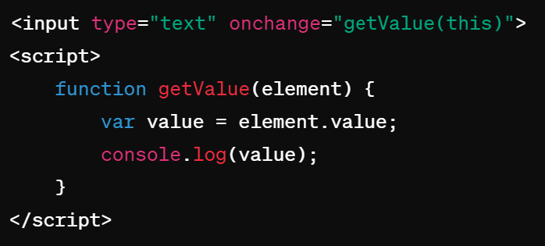
Using this
If you're handling events inline, you can use this to refer to the current element.

Slide 9
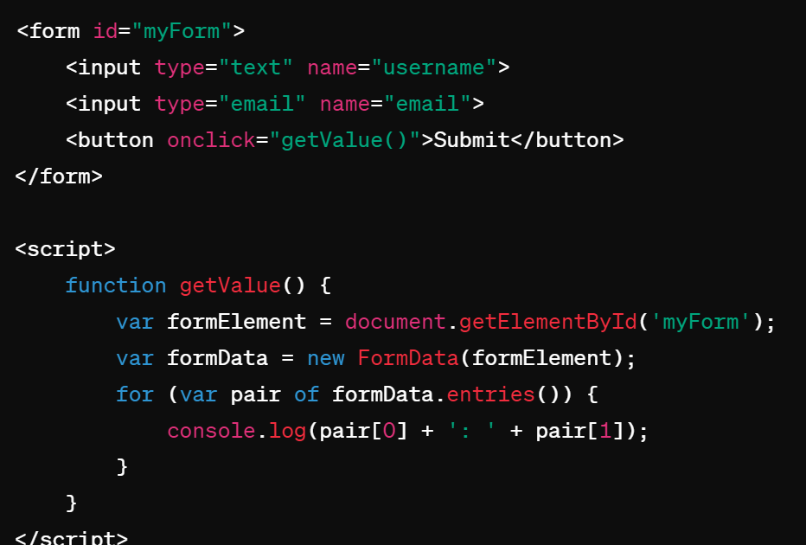
Using FormData object
Forms submitted via AJAX, you can use the FormData object to collect all form field values.

Slide 10
GETTING VALUES FROM JS TO HTML(FORMS)
Using innerHTML
Using textContent
Using attributes
Using appendchild()
Using template literals(ES6)

Slide 11
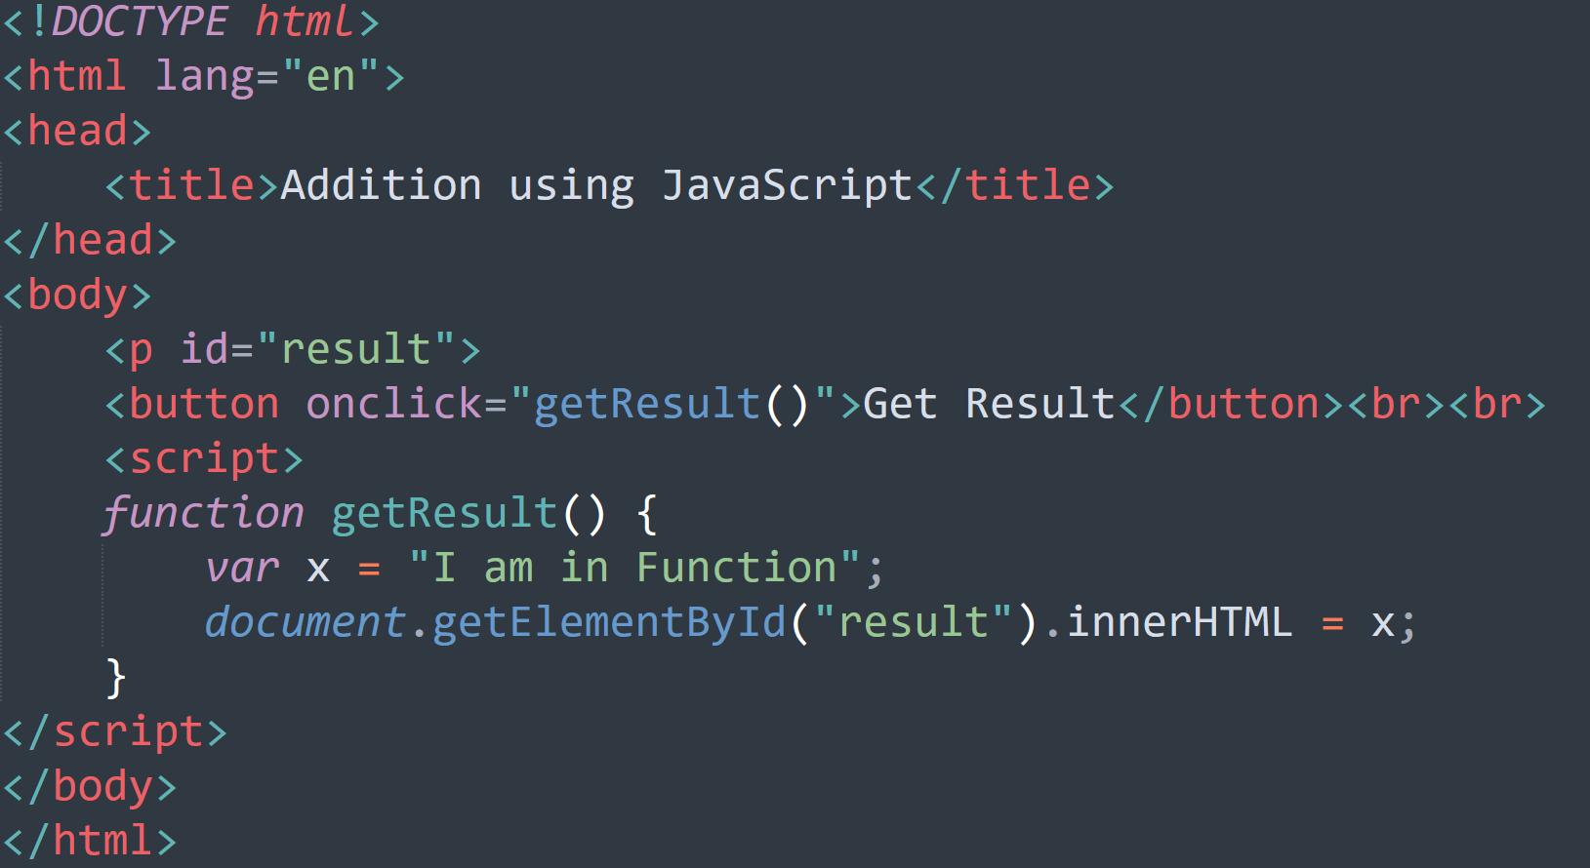
innerHTML

Slide 12
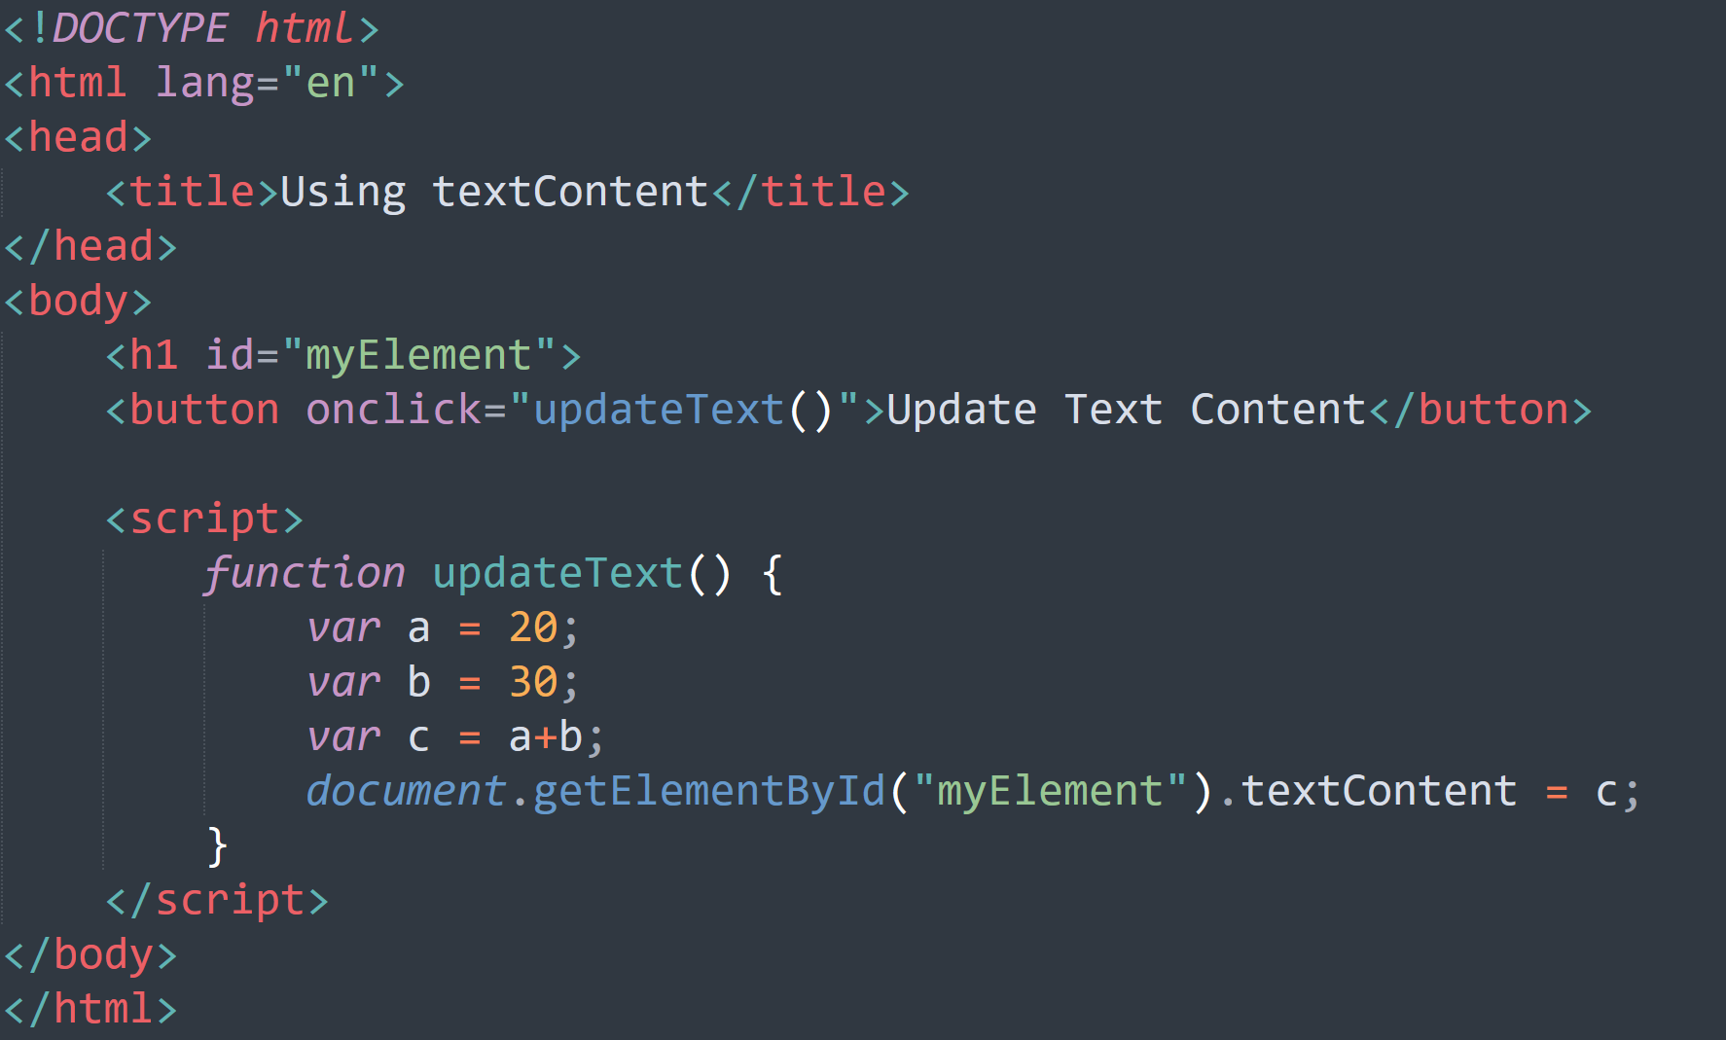
Using textContent

Slide 13
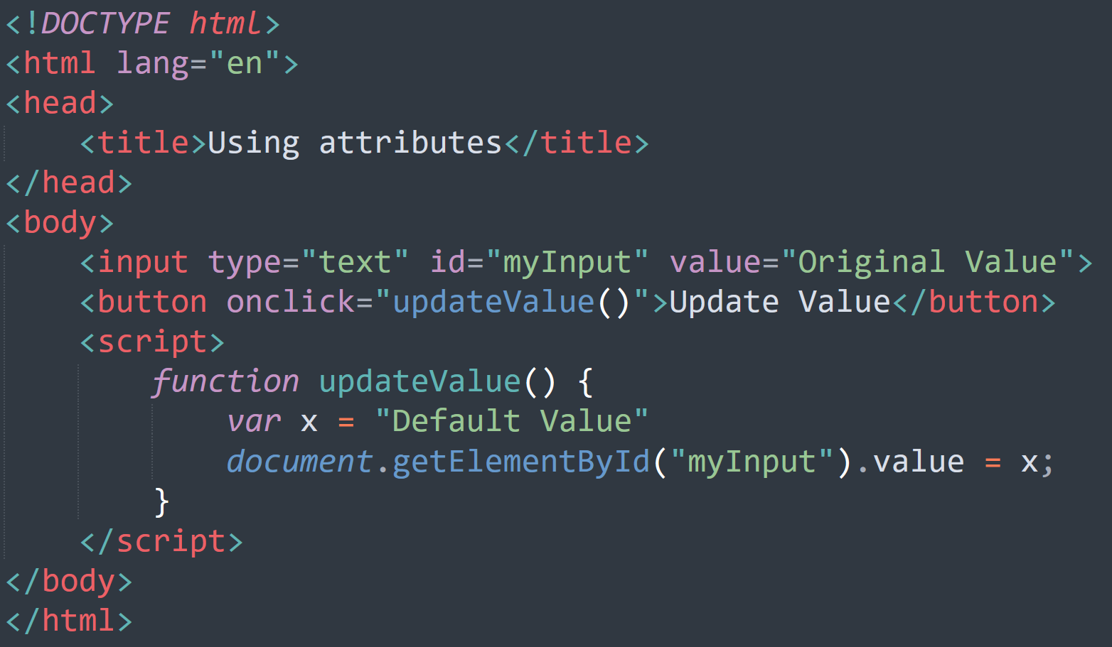
Using attributes

Slide 14
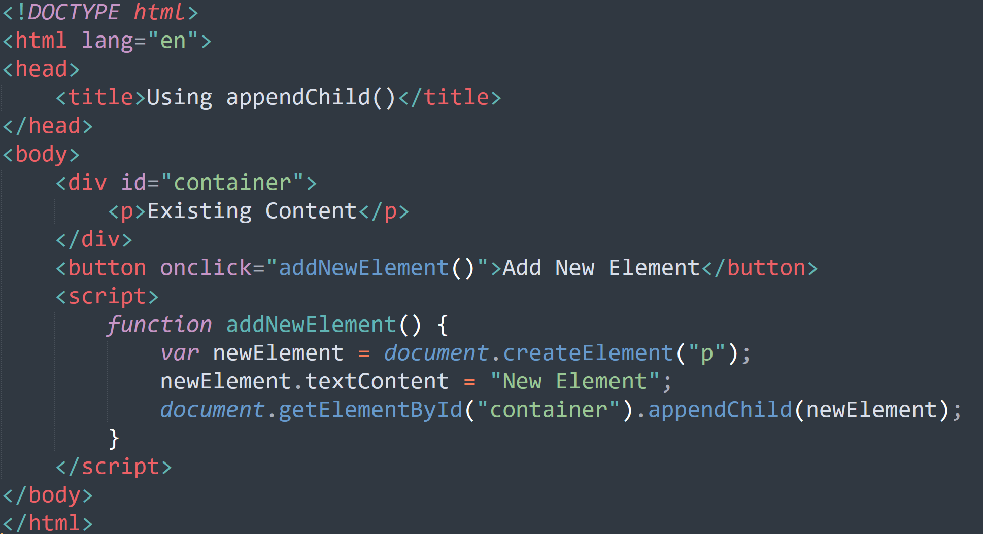
Using appendchild()
This will be useful when we want to add external data to existing data.

Slide 15
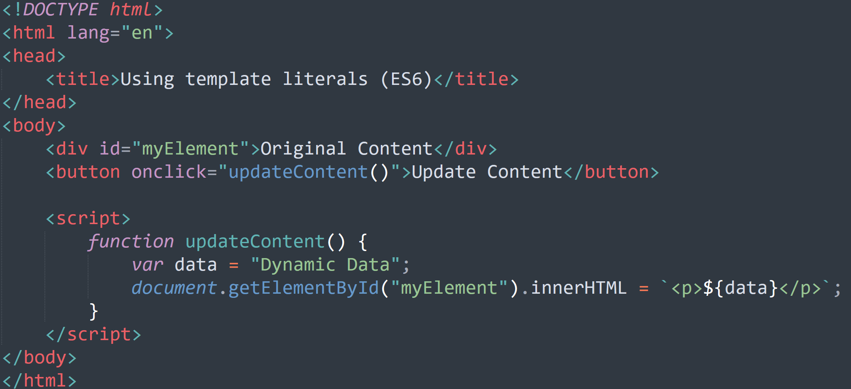
Using template literals(ES6)

